Slide 1
Prediction of trending status for a YouTube video using machine learning method
Machine learning-CSCE 5215 Section 005

Slide 2
participants:
Karthik Undi-11666360
Surya Vardhan Kadiyala-11709167
Vinay Kusuma-11706797

Slide 3
Abstract
In the era of digital media, YouTube has become a vital resource for both users and content producers. Viewers, advertisers, and content producers can all benefit from an understanding of the mechanisms behind YouTube trending patterns and video popularity. In order to meet this demand, our project will create a predictive model that can predict if a YouTube video will become popular within a week of its release.
The project makes use of a dataset from the "USvideos.csv" file, which contains information on YouTube videos including views, likes, dislikes, the number of comments, the publish date, and the time. The main goal is to forecast the "day-to-trend," a binary classification issue that asks whether a video will become popular a week after it is released. These predictions are generated using a powerful machine learning model called the Random Forest Classifier. To provide a thorough evaluation of the model's predictive power, multiple metrics are used to analyse the model's performance, including the F1 score, Mean Accuracy, and Out of Bag score.

Slide 4

This project concludes by outlining a methodical strategy for identifying and forecasting YouTube video trends. The project offers a platform that helps different stakeholders make educated decisions by utilising machine learning techniques and a rich dataset. In the ever-changing world of digital media, the insights produced by this project can be used by content creators wishing to attract a wider audience, marketers hoping to optimize their campaigns, or consumers hoping to keep up with the latest trends. The initiative highlights how data-driven methods have the power to revolutionize how we perceive online video-sharing sites like YouTube.

Slide 5
ML Problem specification:
The dataset used in this project is ‘USvideos.csv’, which contains data about YouTube videos.
The data includes features like views, likes, dislikes, comment count, publish date, and time.
The target variable is ‘day-to-trend’, which represents the number of days a video takes to get on the trending list. This is a binary classification problem where the aim is to predict whether a video will trend within a week of being published.

Slide 6

The model used for this task is the Random Forest Classifier. The performance of the model is evaluated using metrics like Out of Bag score, Mean Accuracy, and F1 score.
Grid search is used to find the best parameters for the model. The features used for training the model are ‘views’, ‘likes’, ‘dislikes’, ‘publish_wd’, and ‘publish_hr’.
The model is trained on a subset of the data where comments are disabled to reduce training time. The model’s feature importance's are also calculated to understand the contribution of each feature to the prediction. The results are then analysed and interpreted.

Slide 7
Data Specification:
The dataset used in this project is ‘USvideos.csv’, which contains data about YouTube videos. The dataset includes features like views, likes, dislikes, comment count, publish date, and time. The target variable is ‘day-to-trend’, which represents the number of days a video takes to get on the trending list. The features used for training the model are ‘views’, ‘likes’, ‘dislikes’, ‘publish_wd’, and ‘publish_hr’.
The type of samples in the dataset are YouTube videos and the number of samples is the length of the data. The length of the data is 40949.

Slide 8
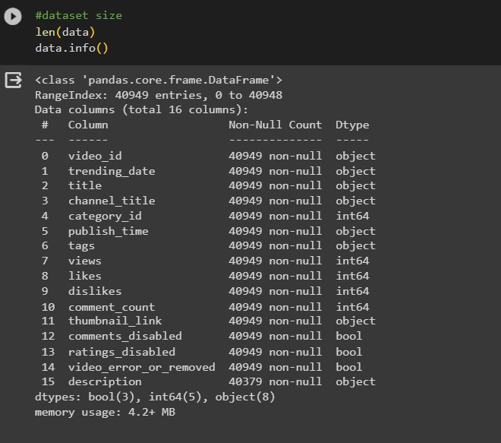
Design and milestones
Data Import and Inspection: The data is imported from the ‘USvideos.csv’ file using the pandas library in Python. The structure of the data is inspected using methods like head(), info(), and Len() to understand the dataset’s size and the types of variables it contains.

Slide 9
2. Data Preprocessing: The date and time columns in the dataset are converted to the appropriate format using pandas. New columns for publish date and time are added. Unnecessary columns are dropped, and duplicates are removed from the dataset.
Data set
missing values, converting date/time to format, and selecting relevant features
This is the output after preprocessing the data by removing comments, changing date time format

Slide 10
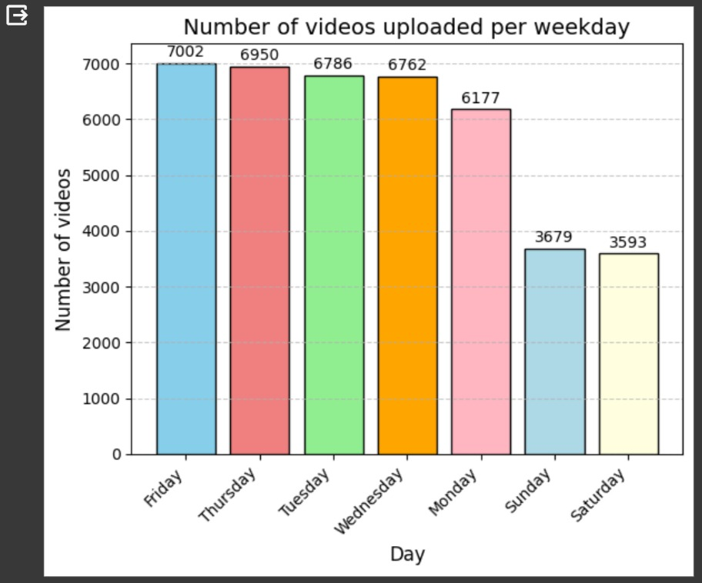
3. Exploratory Data Analysis The number of videos uploaded per weekday is visualized using a bar chart created with matplotlib. This provides an initial understanding of the data distribution.
This visualization is done based on the publish day uing a bar plot we have observed that most videos are uploaded in YouTube on Friday.

Slide 11
4. Feature Engineering: A new column for the number of days a video takes to get on the trending list is created. The dataset is then filtered to only include videos with disabled comments to reduce training time.
This process is to filer the features based on the model selection by eliminating comments
Data set features
views, likes, dislikes, comment count, publish date, and time
views, likes, dislikes, publish_wd, and publish_hr
Feature Engineering

Slide 12
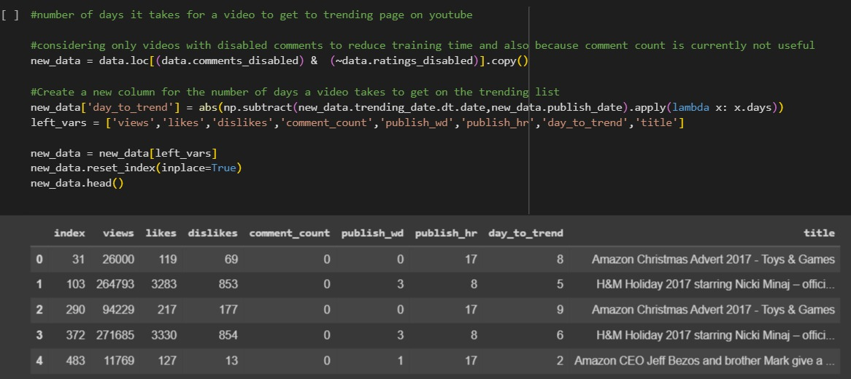
This is the output screen shot after feature engineering

Slide 13
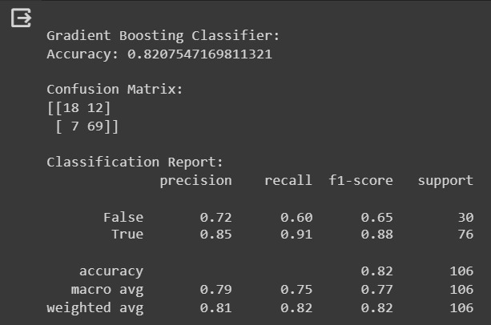
4. Model selection: we have considered various classification models such as gradient boosting and random forest for this project.
We have decided to use these model because this are a ensemble methods which are responsible for better accuracy.
gradient boosting: Gradient Boosting is an ensemble learning method that sequentially builds a series of weak models, typically decision trees, and combines their predictions to form a strong predictive model. It belongs to the family of boosting algorithms, where each subsequent model corrects the errors of the previous ones.

Slide 14
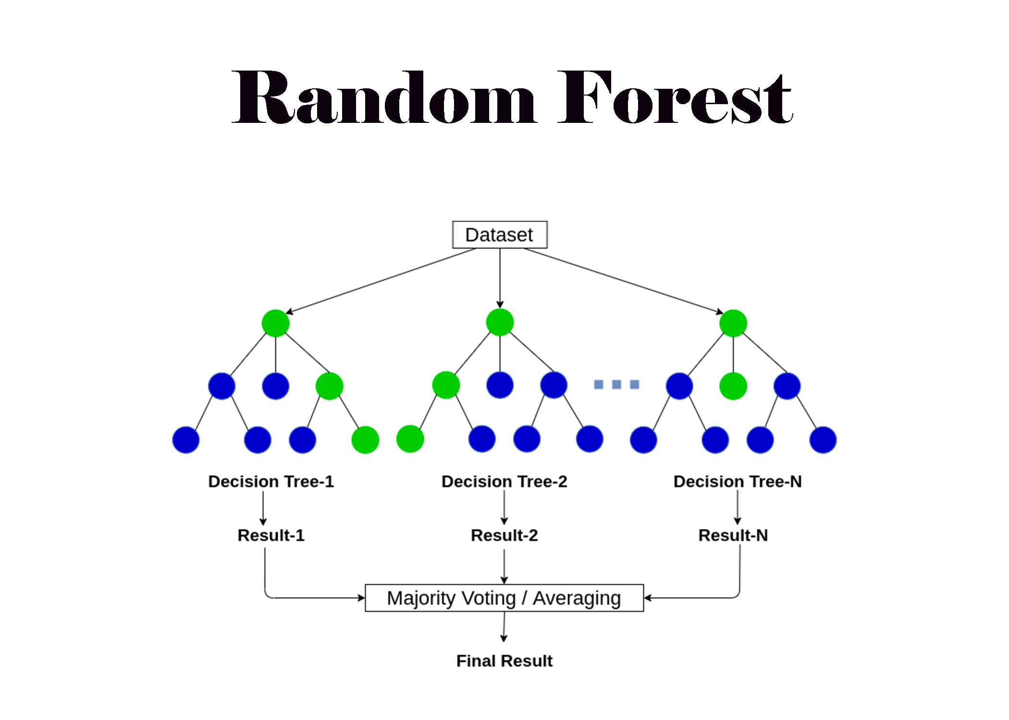
Random forest classifier: Random Forest is an ensemble learning technique that operates by constructing multiple decision trees during training and outputs the aggregated result of these trees. It belongs to the bagging family of ensemble methods, which aims to reduce overfitting and improve the model's generalization.
We have implemented both the classifier and observed the accuracy then finally we decided to use random forest classifier

Slide 15
Ensemble methods:
In this project we use gradient boosting and random forest classification because these methods are useful for better accuracy and we are not separately implementing ensemble methods but the classifiers we use is it self a ensemble method.
We have choosed Random Forest algorithm which is well suited for non-Gaussian/non-normalized data due to its ensemble nature.it builds numerous decision trees that independently train on random subsets of data and features the model is able to accurately represent intricate, nonlinear interactions. Because taking the average of numerous trees lessens the influence of outliers Random Forest is adaptable to different types of data, managing both linear and non-linear correlations which our data contains. It is more successful in situations where Gaussian assumptions would not hold true because of its decreased overfitting and flexibility to various patterns.

Slide 16
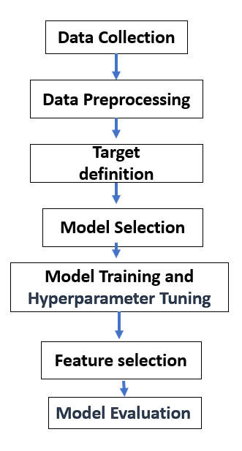

Slide 17
5.Model training and evaluation:
Data set
Training data set
Test data set
Validation set
Hyper parameter tuning:
After training the model , we have done grid search which is helpful for hyper tuning the parameters.
After performing the grid search we obtained maximum depth and n_estimators and also give best score .

Slide 18
The Random Forest Classifier model from the sklearn library is used for prediction. The features used for training the model are ‘views’, ‘likes’, ‘dislikes’, ‘publish_wd’, and ‘publish_hr’. The data is split into training and testing sets using the train_test_split method from sklearn. Grid search is performed to find the best parameters for the model. The model’s performance is evaluated using metrics like Out of Bag score, Mean Accuracy, and F1 score. The feature importances are also calculated to understand the contribution of each feature to the prediction.
Metrics used
Obb score
accuracy
F1 score
precision
recall
Mean accuracy

Slide 19
References and related projects:
https://www.kaggle.com/code/westoon/exercise-summary-functions-and-maps\
https://github.com/ashutoshkrris/YouTube-Trending-Videos-Analysis
https://scikit-learn.org/stable/modules/generated/sklearn.ensemble.RandomForestClassifier.html
https://scikit-learn.org/stable/modules/grid_search.html
https://www.kdnuggets.com/2022/10/hyperparameter-tuning-grid-search-random-search-python.html
https://scikit-learn.org/stable/modules/generated/sklearn.ensemble.GradientBoostingClassifier.html

Slide 20
Thank you

